Slide 1
Ex-509 Data exfiltration (ab)using X.509 certificates
By: Adeem Mawani

Slide 2
What is X.509?

Slide 3
X.509
Standard defining the format of certificates
Certificates associate cryptographic key pairs with identities
Basis for implementing widespread PKI (Public-Key Infrastructure)
Many popular applications today
Electronic signatures
S/MIME (Secure/Multipurpose Internet Mail Extensions) for emails
TLS (Transport Layer Security) / now deprecated SSL (Secure Sockets Layer)

Slide 4
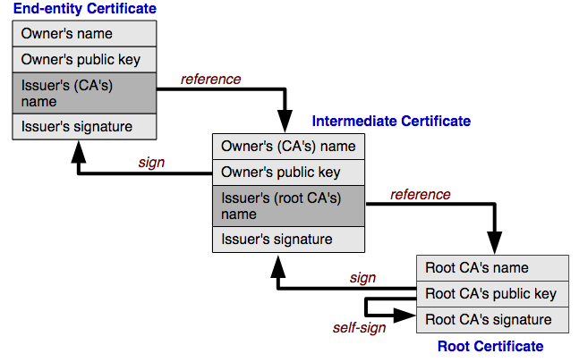
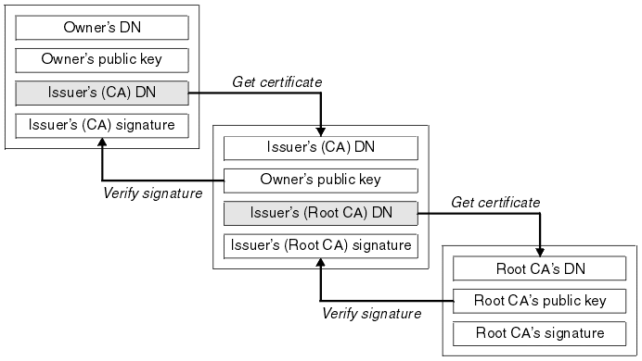
Notes:
PKI
showing distinguished names of subjects (common name and location / address)
Chain of trust

Slide 6
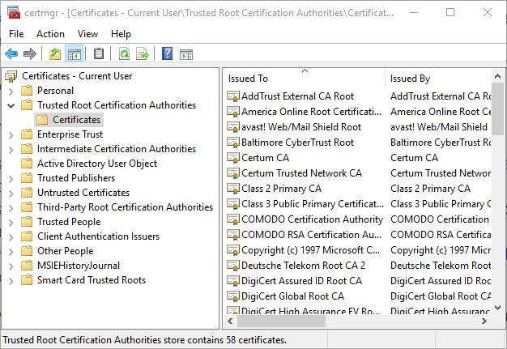
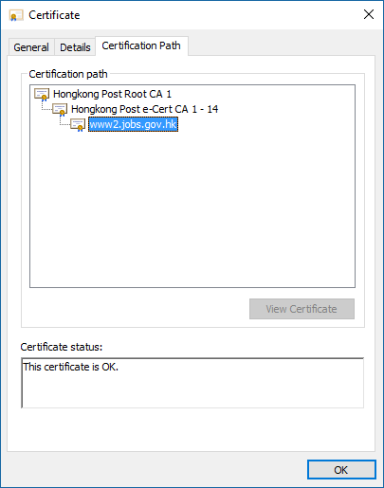
Notes:
Trust store usually managed by the OS
Couple hundred trusted by Windows

Slide 7
How does this relate to TLS?

Slide 8
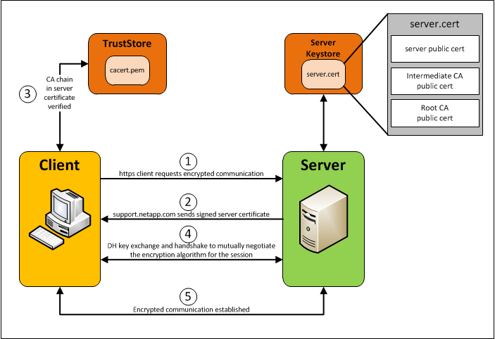

Slide 9
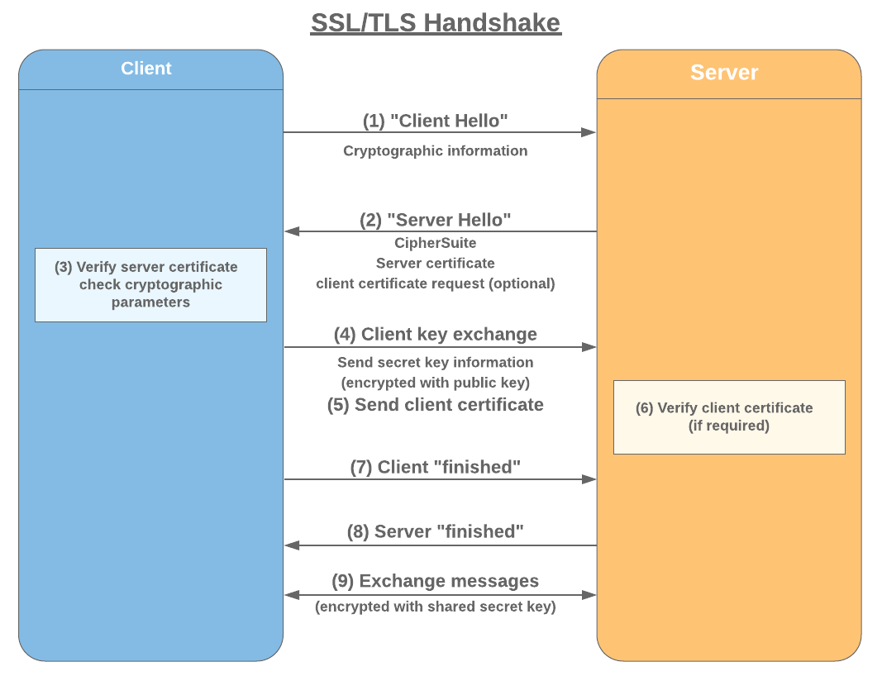

Slide 10
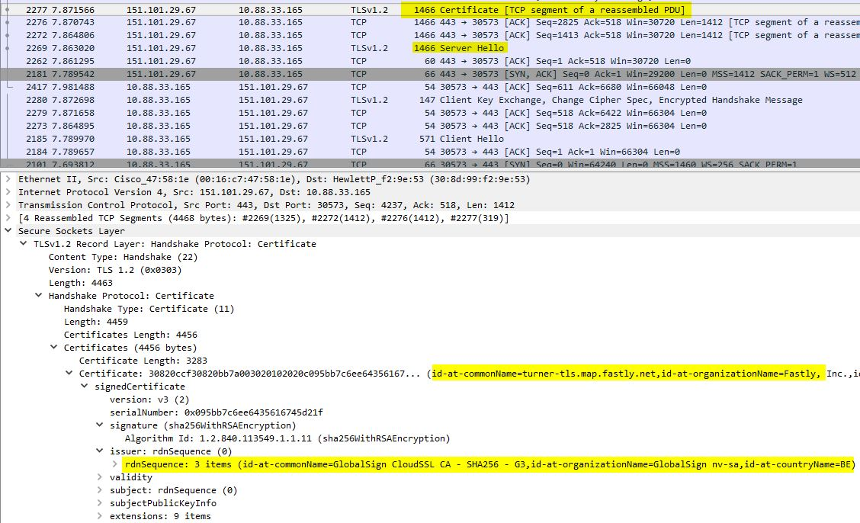

Slide 11
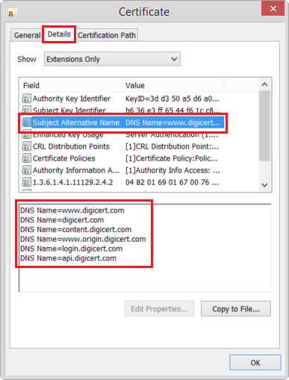
SAN Extension
Allows specification of multiple names to be associated with a single certificate
Email addresses
IP addresses
URIs
DNS names
Good place to put arbitrary values

Slide 12
How Ex-509 Works
Uses TLS Client Authentication / Mutual TLS where both client and server send certificates during the handshake
Stores payload data in the subjectAltName (SAN) field of the client certificate(s)
Transfers the data back to the attacker's machine during the TLS handshake itself
Exfiltration is harder to detect, since the transfer happens before the actual TLS session is established

Slide 13

Ex-509
03
01
TLS handshake performed, and certificates exchanged
Attacker’s machine listens for connections
Client establishes TCP connection with attacker
Attacker rejects client certificate, and closes connection before session is established
02
04

Slide 14
But can we do better?

Slide 17
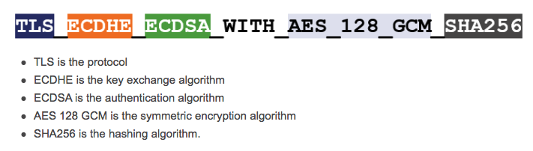
Notes:
Shown in RFC spec
8 bits is 1 byte,
2 byte identifier

Slide 18
Limitations :/
RFC Specification limits max Cipher Suite size to be 2^16 - 2
2 byte size specifier preceding Cipher Suite list
Max size is 0xFFFF or 65,535 bytes of Cipher data
Limited to 65,534 bytes by spec
This is 65KB, so anything bigger gets chunked up and sent in several client hello messages
Another (not so bad) issue
Since cipher suites have 2 byte grouping identifiers, payload data must be % 2 = 0
If it’s not, just pad the data with single zero / null byte (0x00)
CipherSuite cipher_suites<2..2^16-2>;
TLS_RSA_WITH_NULL_MD5 = { 0x00,0x01 }; TLS_RSA_WITH_NULL_SHA = { 0x00,0x02 };
TLS_RSA_WITH_NULL_SHA256 = { 0x00,0x3B }; TLS_RSA_WITH_RC4_128_MD5 = { 0x00,0x04 }; TLS_RSA_WITH_RC4_128_SHA = { 0x00,0x05 }; TLS_RSA_WITH_3DES_EDE_CBC_SHA = { 0x00,0x0A }; TLS_RSA_WITH_AES_128_CBC_SHA = { 0x00,0x2F }; TLS_RSA_WITH_AES_256_CBC_SHA = { 0x00,0x35 }; TLS_RSA_WITH_AES_128_CBC_SHA256 = { 0x00,0x3C }; TLS_RSA_WITH_AES_256_CBC_SHA256 = { 0x00,0x3D };
...
Notes:
Another thing: shows unknown cipher if grouping isn’t known so could look suspicious

Slide 19
PoC Demo
https://github.com/adeemm/ex-509
Requires:
Python >= 3.6

Slide 20
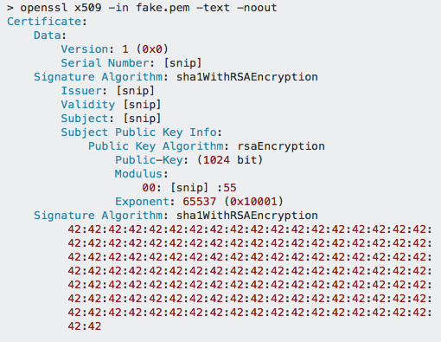
Closing Thoughts
Experimented with storing data in the modulus of the public key or signature
Causes certificate verification problems
Hard to access after incomplete handshake
OpenSSL complains a lot
Had to manually patch certificate output
Solution is not elegant
Logging can easily mitigate
Alert when encountering weird / malformed
data in these fields
Notes:
Log unknown suites for indicator of compromise?

Slide 21
Thank You!
Any questions?

